Slide 1

Where to start
Supporting the decision of the opening a new Databank office

Slide 2
Introduction
My project will determine which neighbourhood is the best suitable for opening a new store, shop, restaurant or similar businesses in the city of Toronto.
Toronto is the financial capital of Canada, therefore there is a lot of presence of big banks. In this project, I will emulate that I am working for a small bank -DataBank- that wants to open an office in Toronto.
The results obtained will help the small bank to decide where to open and which are the main competitors. However, as I said, the aim of this project is to adapt it to any businesses, therefore, results will change depending on which category of business we want to open, obviously.

Slide 3
Introduction
When we are opening a business -our bank office-, we do not want to do it so in a very saturated area in which the competition is very high.
Nevertheless, we also do not want to open it on an area in which there are any similar businesses -meaning that in such area there not exist potential demand.
Therefore, we would want to open it in an area in which the saturation of similar businesses is near the average.

Slide 4
Data used
This project was conceived as the continuity of the previous module. Therefore, the sources of data I am going to use are:
For the neighbourhood locations, the Wikipedia page https://en.wikipedia.org/wiki/List_of_postal_codes_of_Canada:_M
For the venues, the Foursquare API
For creating maps, Folium library
For geospatial data, the csv file of Module 3 https://cocl.us/Geospatial_data

Slide 5
Methodology
Data wrangling
First and foremost, I imported the necessary libraries to operate throughout all the project on a Jupyter notebook. As I said in the data section, I took the data of the neighbourhoods of Toronto from the Wikipedia website. Then, I procceded to create a dataframe in pandas with the names of the neighbourhoods. After that, I dropped all the not assigned values.
From the csv file of Module 3, I took the geospatial data of the neighbourhoods of the previous dataframe and created a new dataframe. Then I merged both datasets in an unique one.

Slide 6
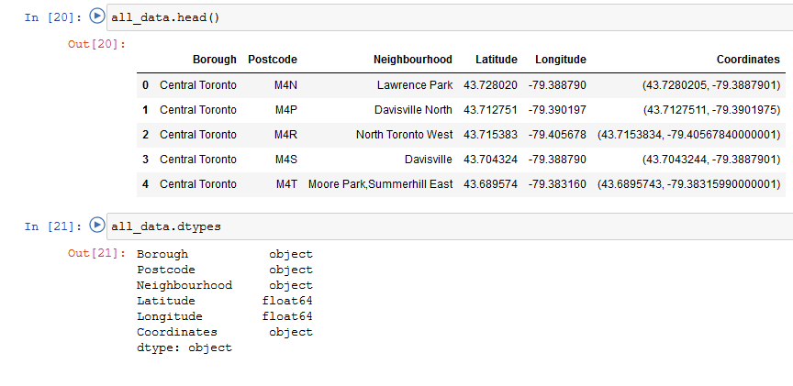
Methodology

Slide 7
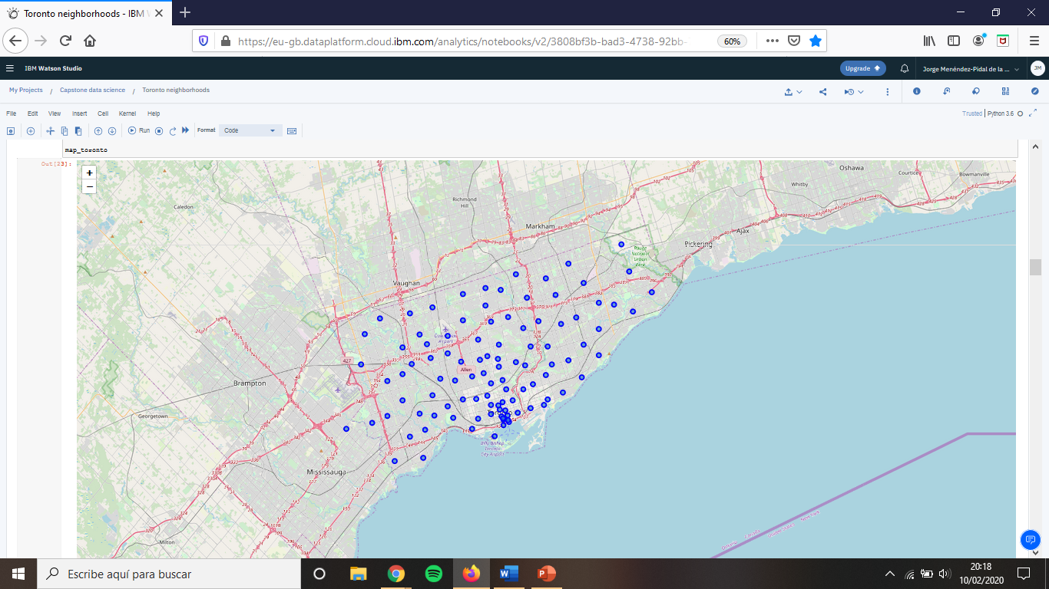
Methodology
Map preparation
Using Folium I created a map for Toronto. I looked for the coordinates in the internet. Then I added markers representing all the neighbourhoods on it.

Slide 8
Methodology
Using the Foursquare API
I got a big dataframe of shape (9935, 7). That was because a lot of values were duplicated, as some neighbourhoods locations are near each other. So I dropped all the duplicated values, resulting in a dataframe of shape (801,7). That means that in Toronto there are 801 distinct bank offices, according to Foursquare.

Slide 9
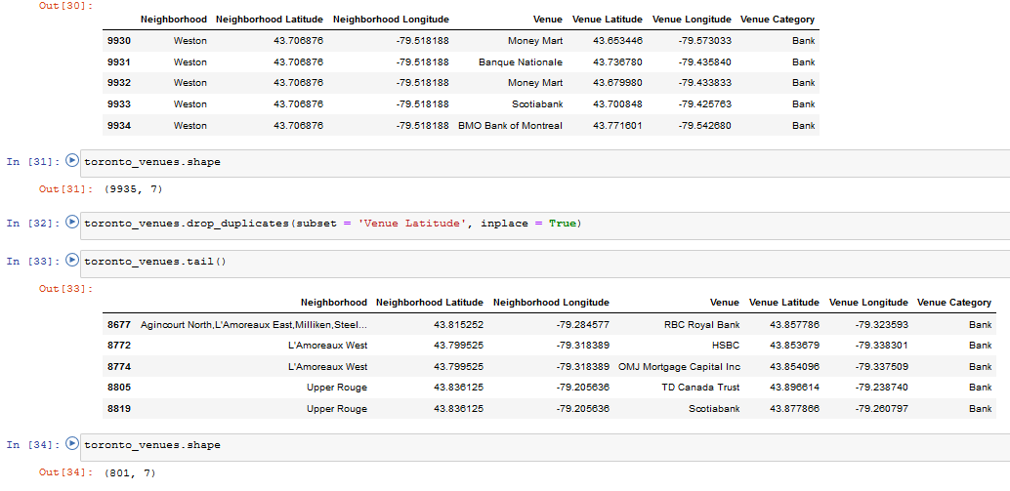
Methodology

Slide 10
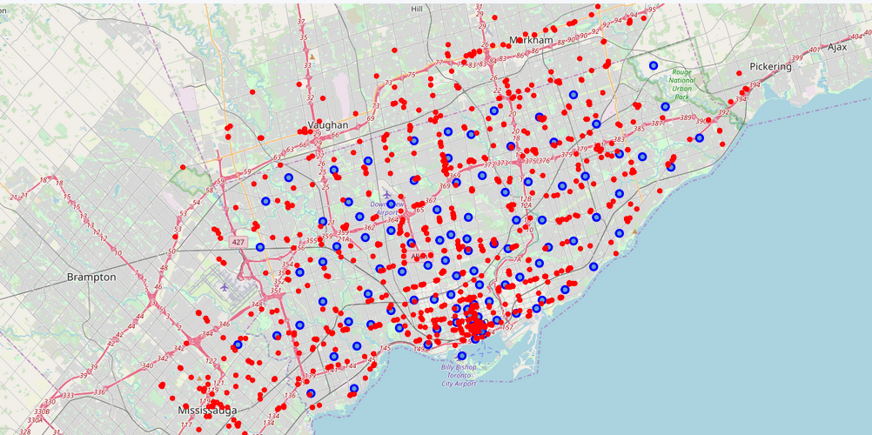

Slide 11
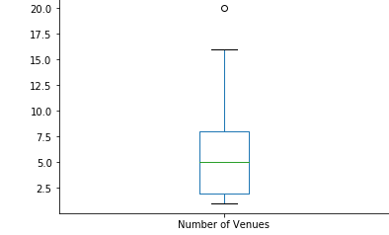
Results
Businesses per neighbourhood
Then, I wanted to analyse the data to see how many similar bank offices each neighbourhood had. In this way, I could determine which neighbourhoods had the best density of offices to open a new one. I plotted a boxplot chart to visualize the distribution of the data.

Slide 12
Results
Clairlea,Golden Mile,Oakridge
Deer Park,Forest Hill SE,Rathnelly,South Hill,...
Downsview West
Downsview,North Park,Upwood Park
Rosedale
Woburn
Woodbine Gardens,Parkview Hill
There was only an extreme value at 20 offices in the neighbourhood. I looked then for the mean of businesses per neighbourhood, and it was 5. The mean was the target of my project, as the neighbourhoods that had that density were nor very saturated nor empty. I searched for the venues with that number of offices. They were 7:

Slide 13
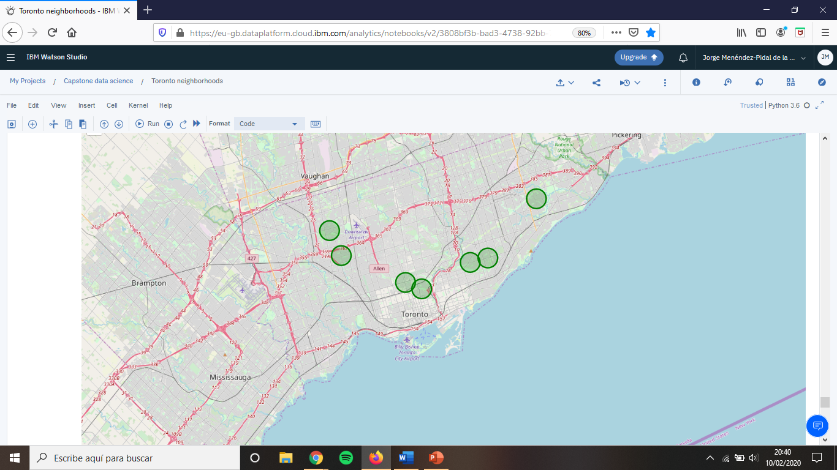
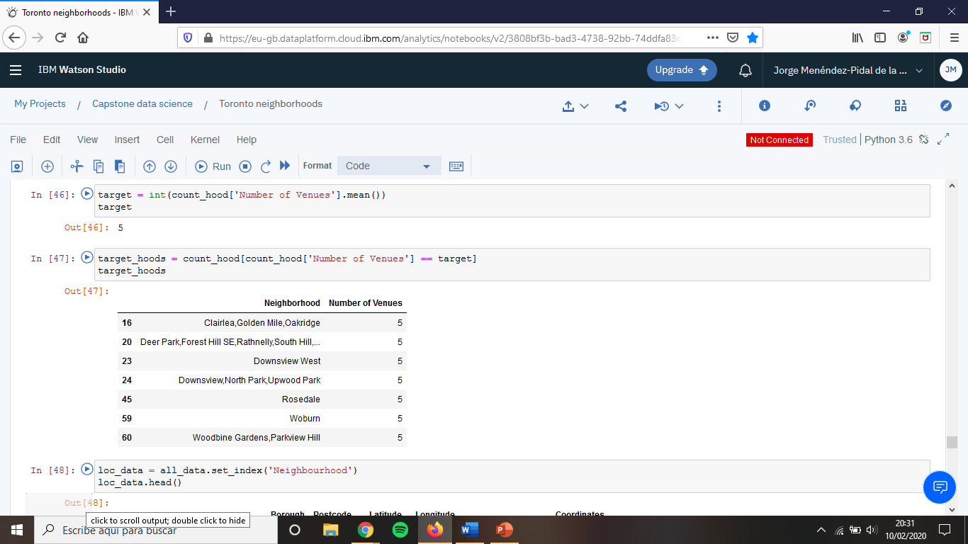

Slide 14
Results
Main competitor
Afterwards, I wanted to search the main competitor DataBanks will face, so I wrangled the data retrieved from Foursquare to see the bank that has the highest number of offices.

Slide 15
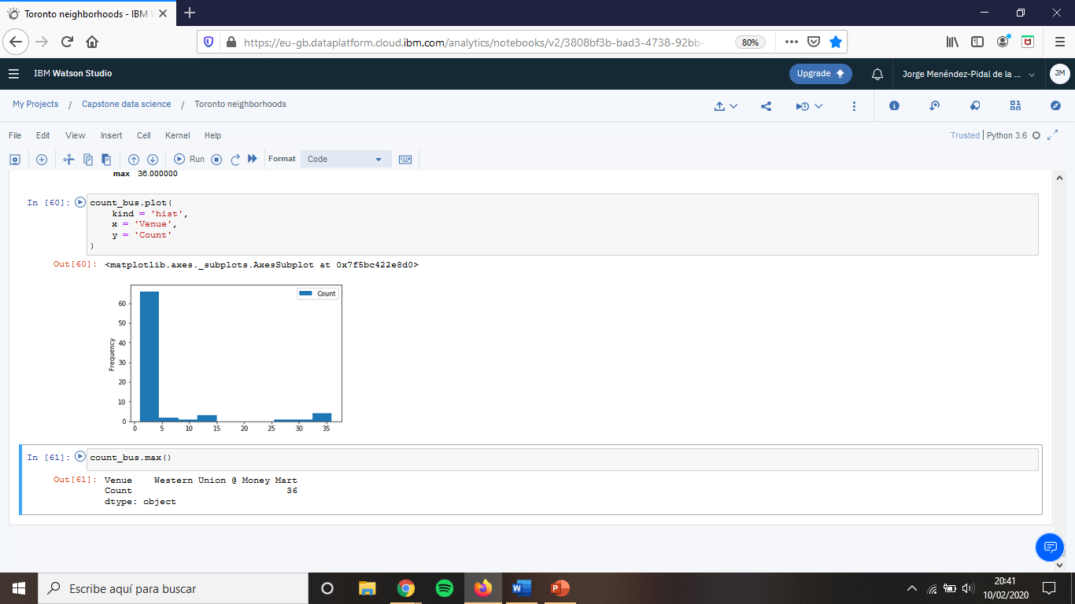
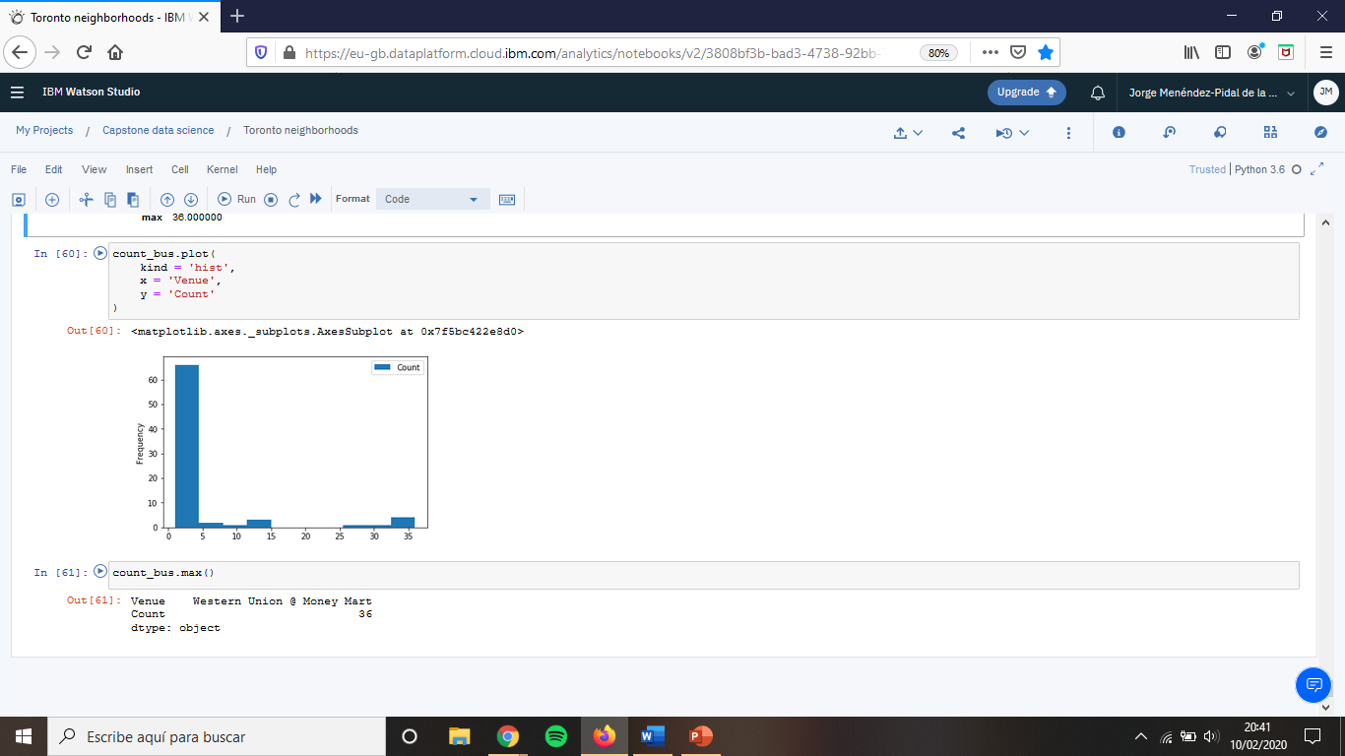
The main competitor for our small DataBank is Western Union @ Money Mart.

Slide 16
Discussion
I recommend the small bank to open the office on the neighbourhoods stated above. However, I would advert them that the results might have been affected by certain limitations.
Firstly, that the data used did not took into account socio-economic factors, which would determine why in some neighbourhoods there are more offices than in others.
Secondly, the Foursquare dataset might be incomplete and it migh not comprise all the venues of the city of Toronto.
Lastly, the data retrieved is a snapshot of the offices active nowadays. However, there is no historical records to look in which neighbourhoods banks are landing or taking off.

Slide 17
Conclusion
Despite the limitations discussed in the previous section. It could be argued that this project has created value for DataBank from a dataset and it may help in the decision-making process in the DataBank headquarters.
In the end, that is one of the goal of the Data Science, so we could say that this project fulfills its purposes.

Slide 18
Thanks for your attention

